Slide 1
Introduction to Software Engineering
Agile Software Development(2)
Muhammad Nasir
m.nasir@iiu.edu.pk

Slide 2
Agenda
Extreme Programming
Planning Activity
Design Activity
  Class Responsibility Collaborator
  Refactoring
Coding Activity
Testing Activity

Slide 3
Extreme Programming
Extreme Programming uses an object-oriented approach as its preferred development paradigm
And encompasses a set of rules and practices that occur within the context of four framework activities: Planning, Design, Coding, and Testing.

Slide 4
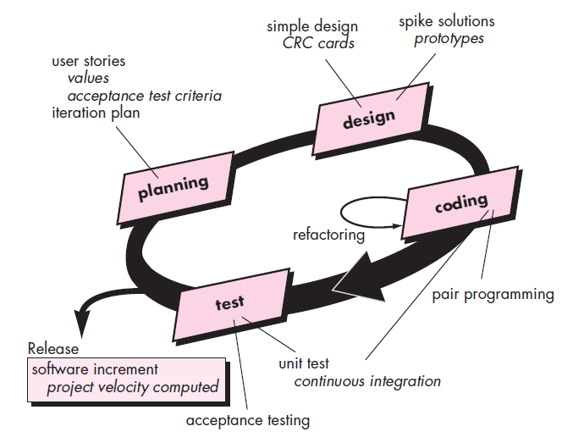
Extreme Programming

Slide 5
Planning Activity
The planning activity (also called the planning game)
Begins with listening—a requirements gathering activity
Listening leads to the creation of a set of “stories” (also called user stories) that describe required output, features, and functionality for software to be built.

Slide 6
Planning Activity
Each story (Use Case) is written by the customer and is placed on an index card.
The customer assigns a value (i.e., a priority) to the story based on the overall business value of the feature or function.
Members of the XP team then assess each story and assign a cost—measured in development weeks—to it.

Slide 7
Planning Activity
If the story is estimated to require more than three development weeks, the customer is asked to split the story into smaller stories
And the assignment of value and cost occurs again.
It is important to note that new stories can be written at any time.

Slide 8
Design Activity
Design provides implementation guidance for a story as it is written —nothing less, nothing more.
The design of extra functionality (because the developer assumes it will be required later) is discouraged.

Slide 9
Design Activity
XP encourages the use of CRC cards as an effective mechanism for thinking about the software in an object-oriented context.
CRC (class-responsibility-collaborator) cards identify and organize the object-oriented classes that are relevant to the current software increment
Notes:
A Class Responsibility Collaborator (CRC) model (Beck & Cunningham 1989; Wilkinson 1995; Ambler 1995) is a collection of standard index cards that have been divided into three sections, as depicted in Figure 1. A class represents a collection of similar objects, a responsibility is something that a class knows or does, and a collaborator is another class that a class interacts with to fulfill its responsibilities. Figure 2 presents an example of two hand-drawn CRC cards.

Slide 10
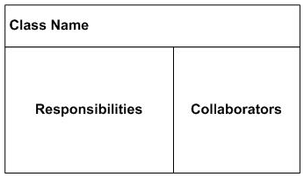
Class Responsibility Collaborator

Slide 11
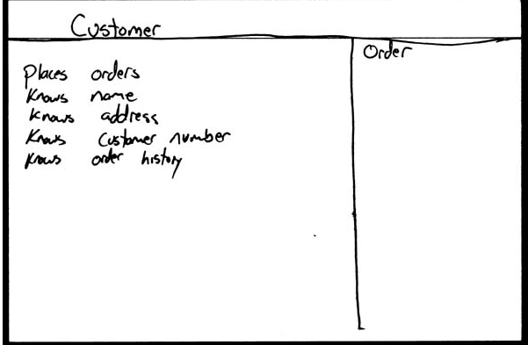
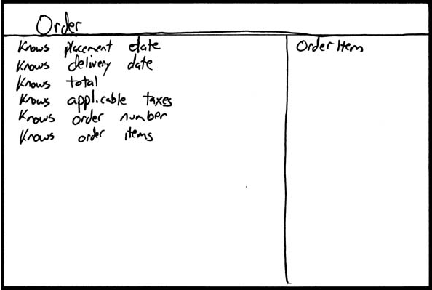
Class Responsibility Collaborator

Slide 12
Design Activity
If a difficult design problem is encountered as part of the design of a story,
XP recommends the immediate creation of an operational prototype of that portion of the design.
Called a spike solution, the design prototype is implemented and evaluated.
Spike solution lower the risk of failure when true implementation starts and to validate the original estimates.

Slide 13
Design Activity - Refactoring
XP encourages refactoring—a construction technique that is also a method for design optimization.
In essence, when you re-factor, you are improving the design of the code after it has been written.

Slide 14
Design Activity - Refactoring
A central idea in XP is that design occurs both before and after coding commences.
Refactoring means that design occurs continuously as the system is constructed.
In fact, the construction activity itself will provide the XP team with guidance on how to improve the design.

Slide 15
Coding Activity
After preliminary design work is done, team does not move the coding
Rather develop the unit tests that will exercise the stories
Developing the unit tests gives developer a better understanding of what is to be developed to pass the test
A key concept of the XP coding activity is pair programming

Slide 16
Coding Activity
This provides a mechanism for real- time problem solving (two heads are often better than one) and real-time quality assurance (the code is reviewed as it is created)
Each developer slightly takes different role i.e. One may code for a portion of code while other may take care of coding standards and quality assurance
Or that the code will satisfy the unit test

Slide 17
Coding Activity
As pair programmers complete their work, the code they develop is integrated with the work of others.
In some cases this is performed on a daily basis by an integration team.
In other cases, the pair programmers have integration responsibility.
This “continuous integration” strategy helps to avoid compatibility and interfacing Issues

Slide 18
Coding Activity
XP acceptance tests, also called customer tests, are specified by the customer and focus on overall system features and functionality that are visible and reviewable by the customer.
Acceptance tests are derived from user stories that have been implemented as part of a software release

Slide 19
Testing Activity
Unit testing is already part of XP approach even before the coding starts
Fixing small problems every few hours takes less time than fixing huge problems just before the deadline.”

Slide 20
Release & Project Velocity
After the first project release (also called a software increment) has been delivered,
The XP team computes project velocity.
Stated simply, project velocity is the number of customer stories implemented during the first release.
Project velocity can then be used to
  (1) Help estimate increment delivery dates and schedule for subsequent releases and
  (2) Determine whether an over-commitment has been made for all stories across the entire development project.

Slide 21
The End
Thanks for listening
Questions would be appreciated.

